Slide 1
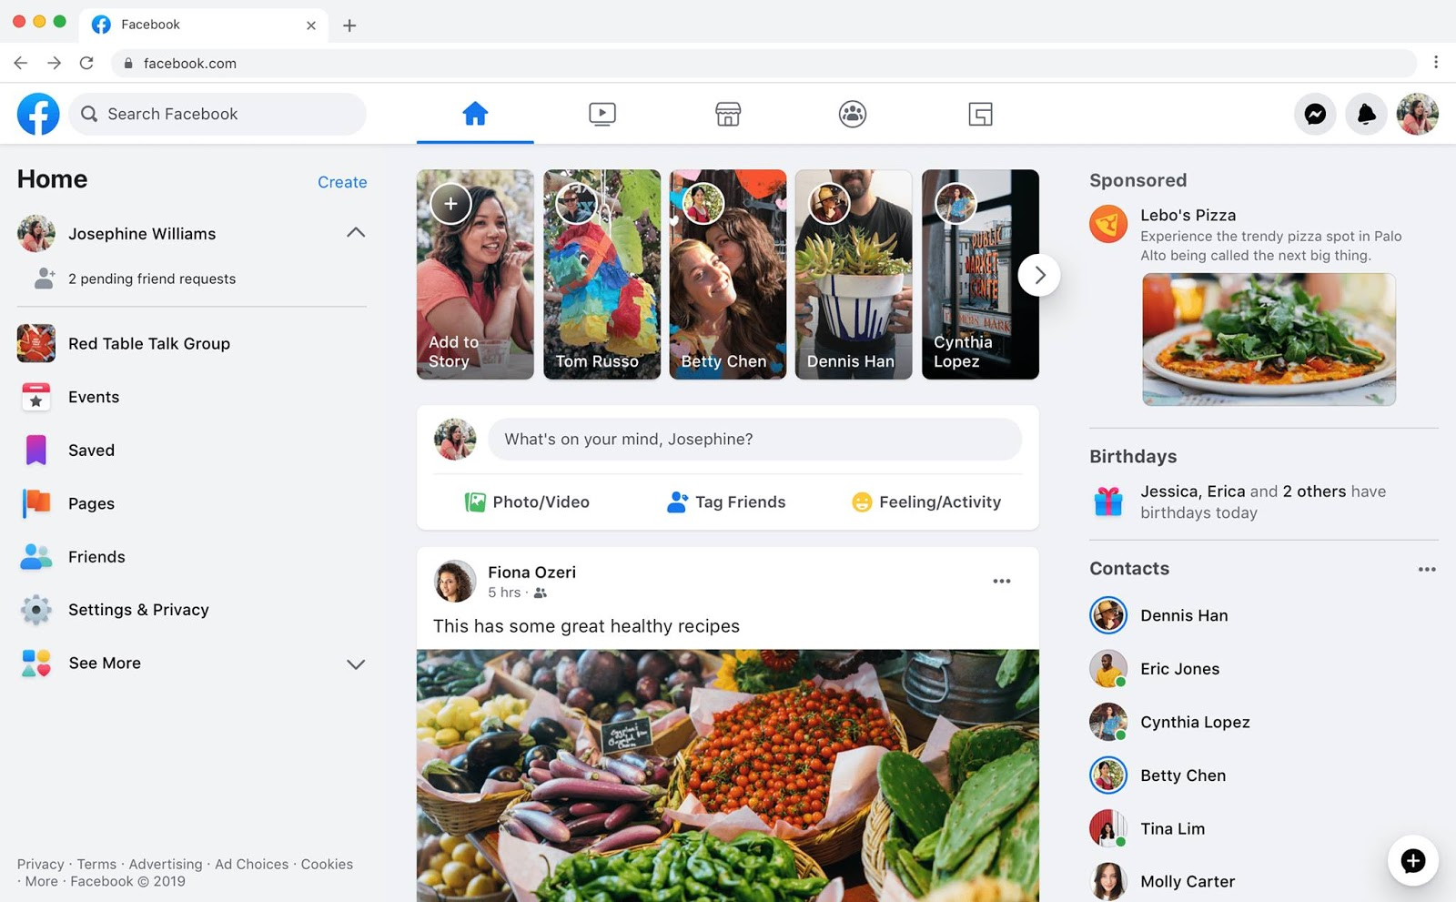
Identify root components of website below

Slide 2
Root: Height: 100vh
Flex: 1
nav
Aside left
header
Aside right
Comment
Card
Flex: 9
Main
Content

Slide 3
Menu | Navigation
Flex 1
Flex 1
Flex 1
Nav-left
Nav-center
Nav-right

Slide 4
Menu | Navigation
Nav-left
Nav-center
Nav-right
icon
Search box
icon
icon
icon
icon
icon
icon
icon
icon
display: flex;
justify-content : flex-start;
Align-items: center;
display: flex;
justify-content : space-between;
Align-items: center;
display: flex;
justify-content : flex-end;
Align-items: center;

Slide 5
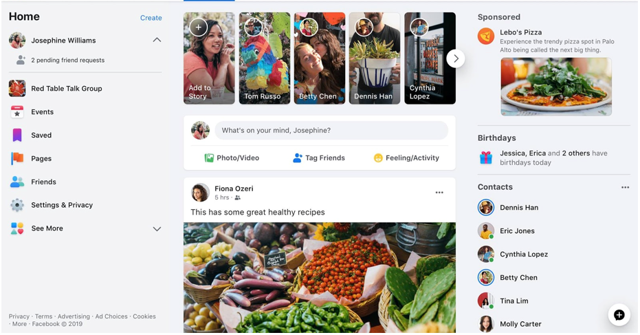
Main | Container

Slide 6
Main | Container
Flex 1
Flex 2
Flex 1
Aside-left
Content
Aside-right

Slide 7
Main | Container
display: flex;
justify-content : space-between;
display: flex;
justify-content : space-around;
logo
banner1
display: flex;
Flex-direction:column;
icon
icon
banner2
icon
icon
display: flex;
Flex-direction: column;
justify-content : flex-start;
display: flex;
Flex-direction: column;
display: flex;
Flex-wrap: wrap;
justify-content : space-around;

